Slide 1
Software Engineering
Homework Alarm System
10조

Slide 2

Contents
System purpose
System Architecture
Based Program
Scenario

Slide 3

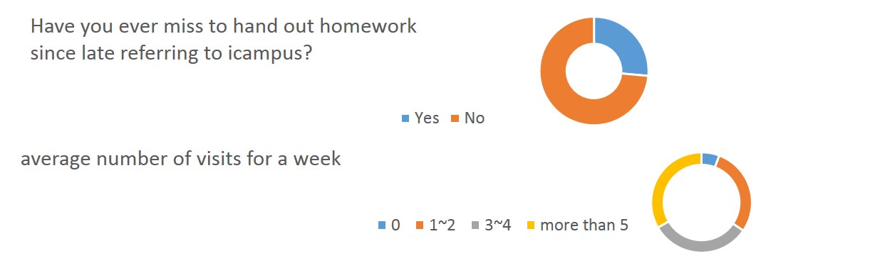
System Purpose

Slide 4
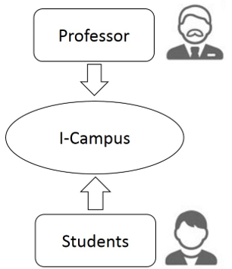



System Purpose
I-Campus

Slide 5
System Architecture
-Architecture Overview
HAS
Professor Login approval
Information Administrator
Set alarm
Send alarm
Edit/Insert/Delete Student information
Edit/Insert/Delete Class information

Slide 6

System Architecture
-Application Overview
Set H/W alarm
Send H/W alarm
Smartphone
Prof. login approval
Home
Information Administrator
Web
Database

Slide 7
System Architecture
-Prof. Log-in approval subsystem
Set H/W alarm
Send H/W alarm
Smartphone
Prof. login approval
Home
Information Administrator
Web
Database

Slide 8
System Architecture
-Information Administrator subsystem
Set H/W alarm
Send H/W alarm
Smartphone
Prof. login approval
Home
Information Administrator
Web
Database

Slide 9
System Architecture
-Set H/W alarm subsystem
Set H/W alarm
Send H/W alarm
Smartphone
Prof. login approval
Home
Information Administrator
Web
Database

Slide 10
System Architecture
-Send H/W alarm subsystem
Set H/W alarm
Send H/W alarm
Smartphone
Prof. login approval
Home
Information Administrator
Web
Database

Slide 11
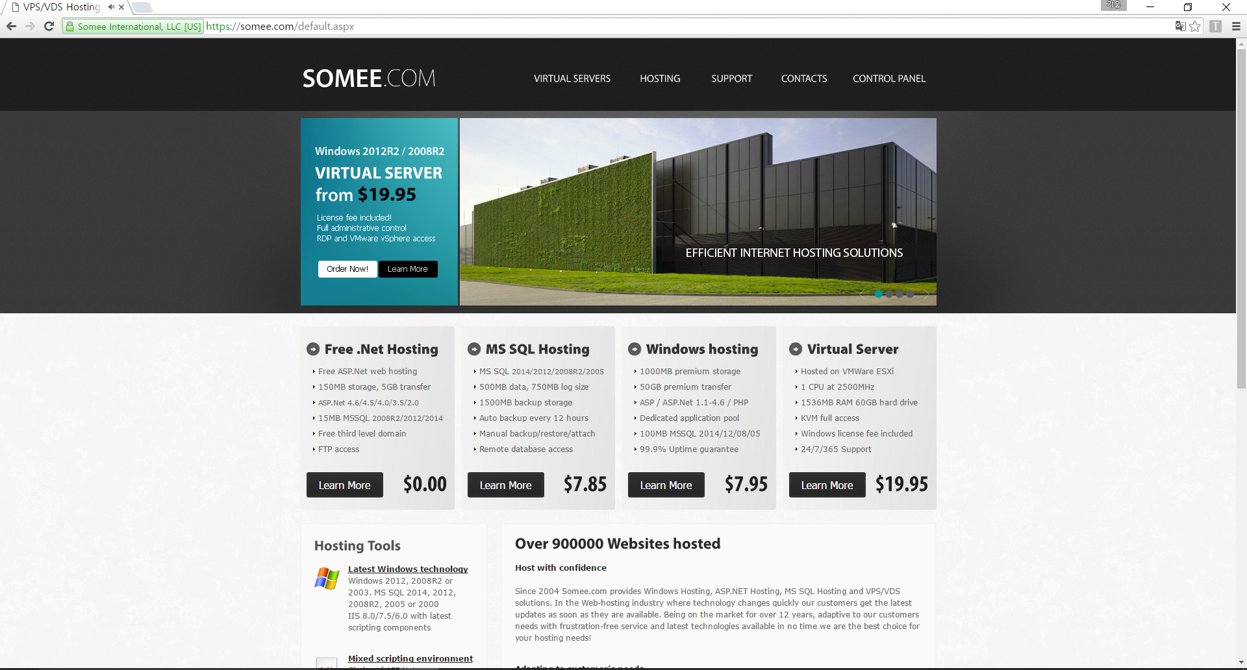
Based Program
-Homepage server from some.com

Slide 12
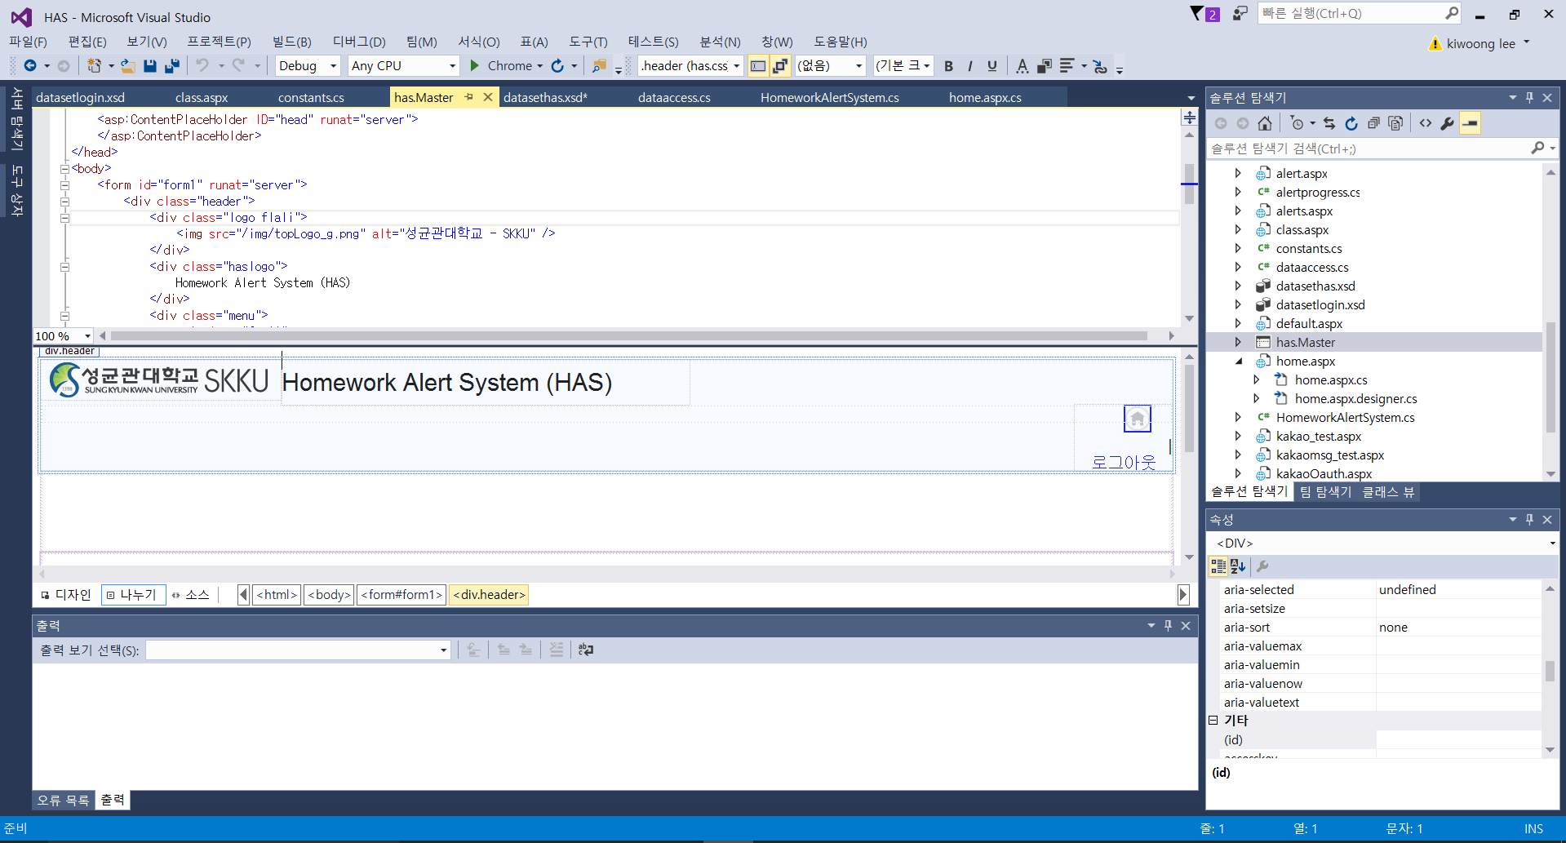
Based Program
-HTML for server design

Slide 13
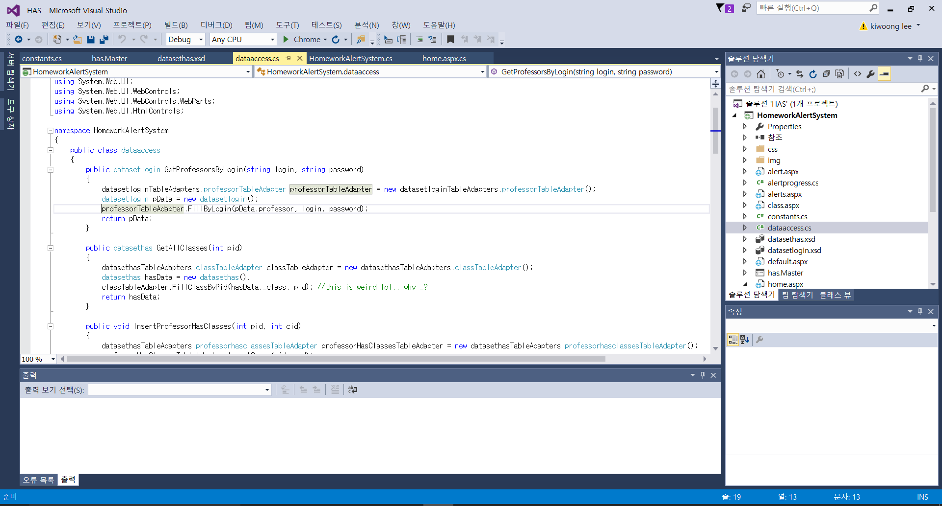
Based Program
-C# for sever tag & database access

Slide 14
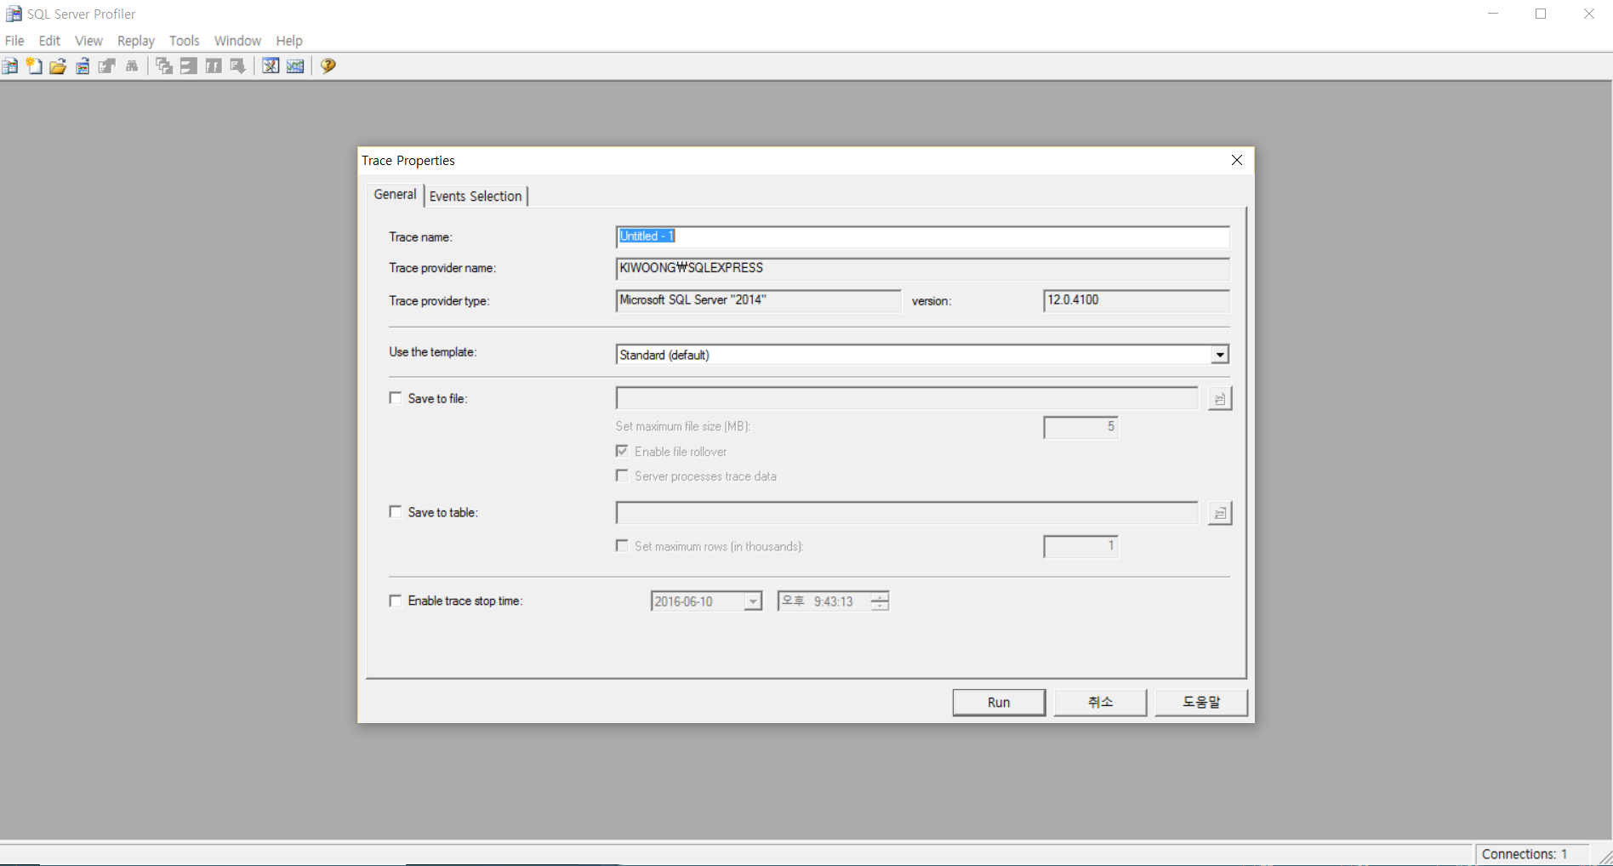
Based Program
-SQL Server for Databases

Slide 15
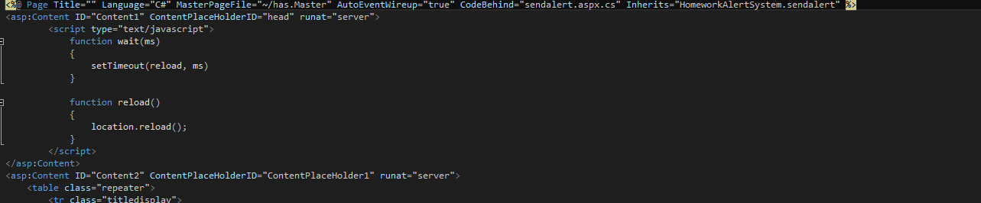
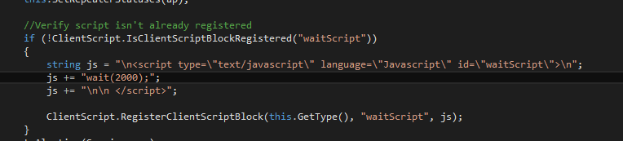
Based Program
-Java script for sending alert

Slide 16
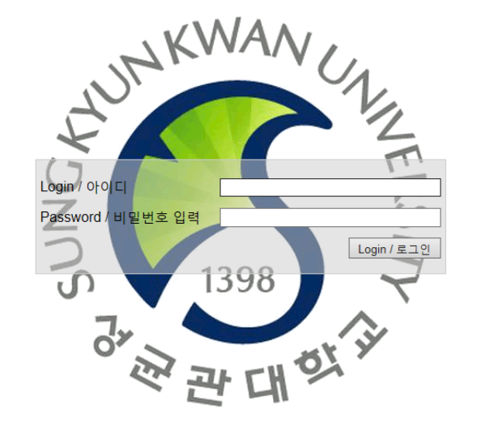
Scenario
-Login

Slide 17
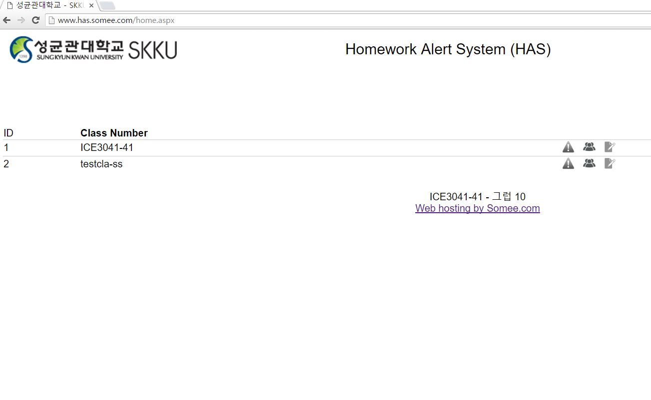
Scenario
-Home
Edit Class

Slide 18
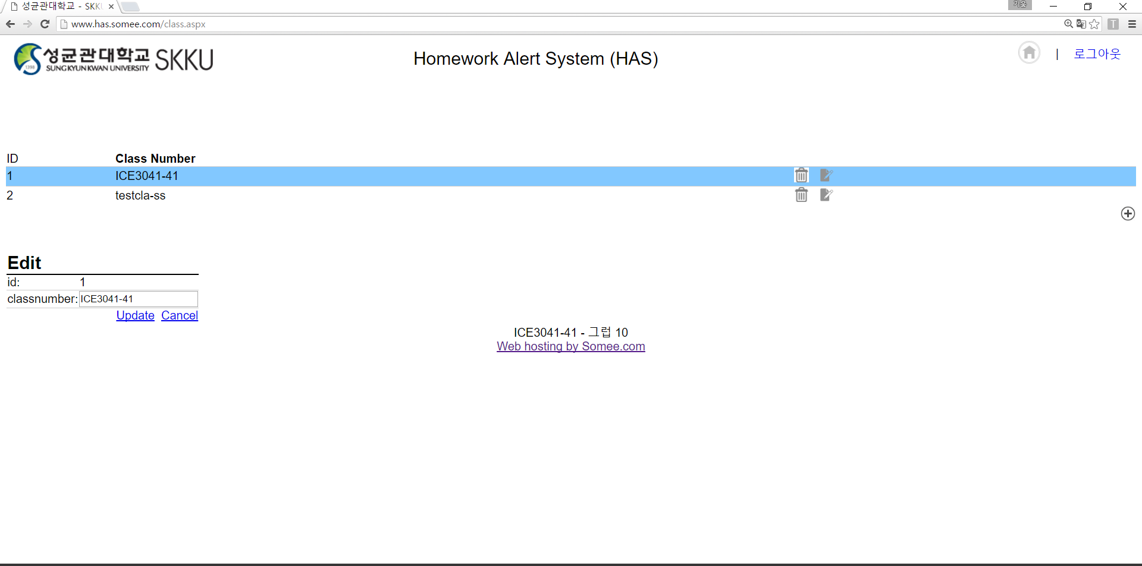
Scenario
-Edit Class

Slide 19
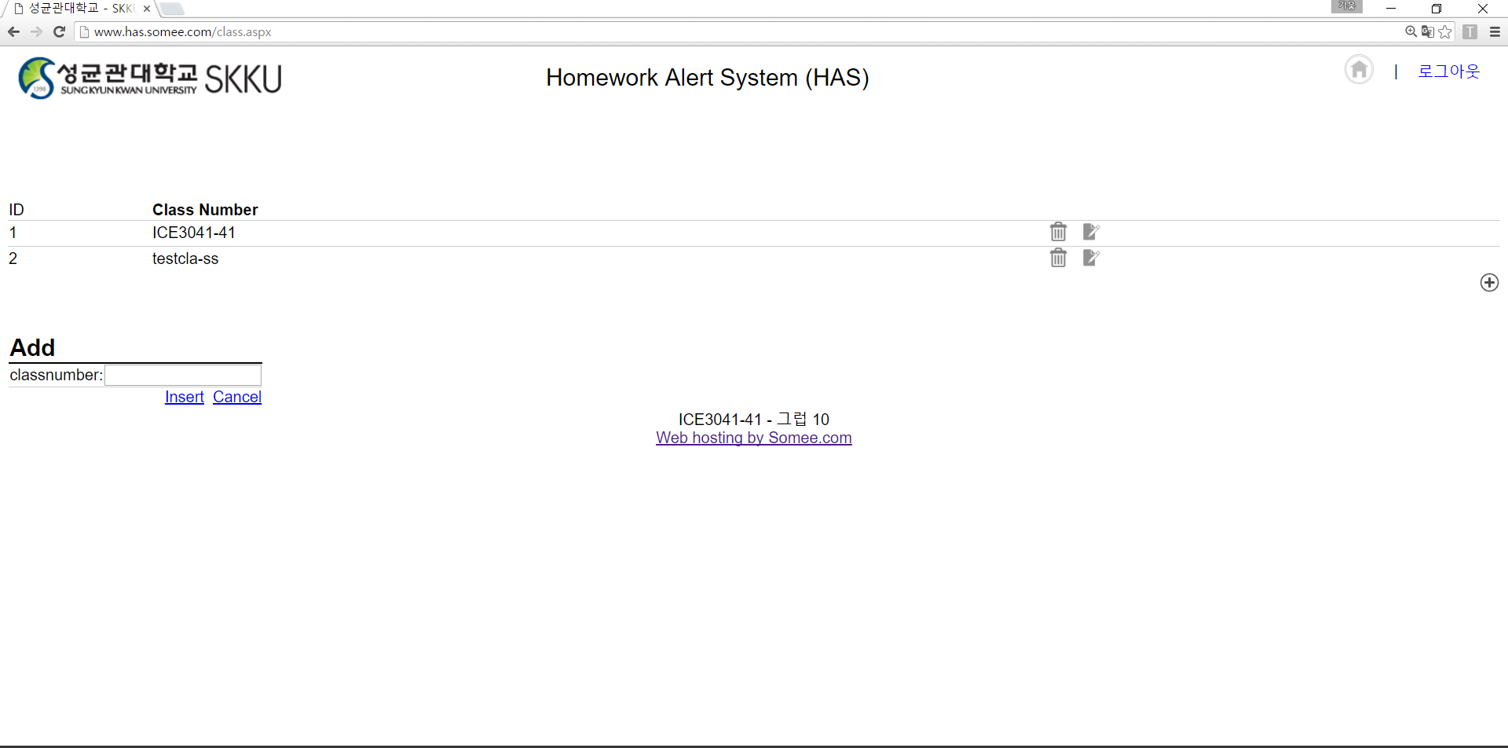
Scenario
-Edit Class
You can go ‘Home’

Slide 20
Scenario
-Home
Edit Student

Slide 21
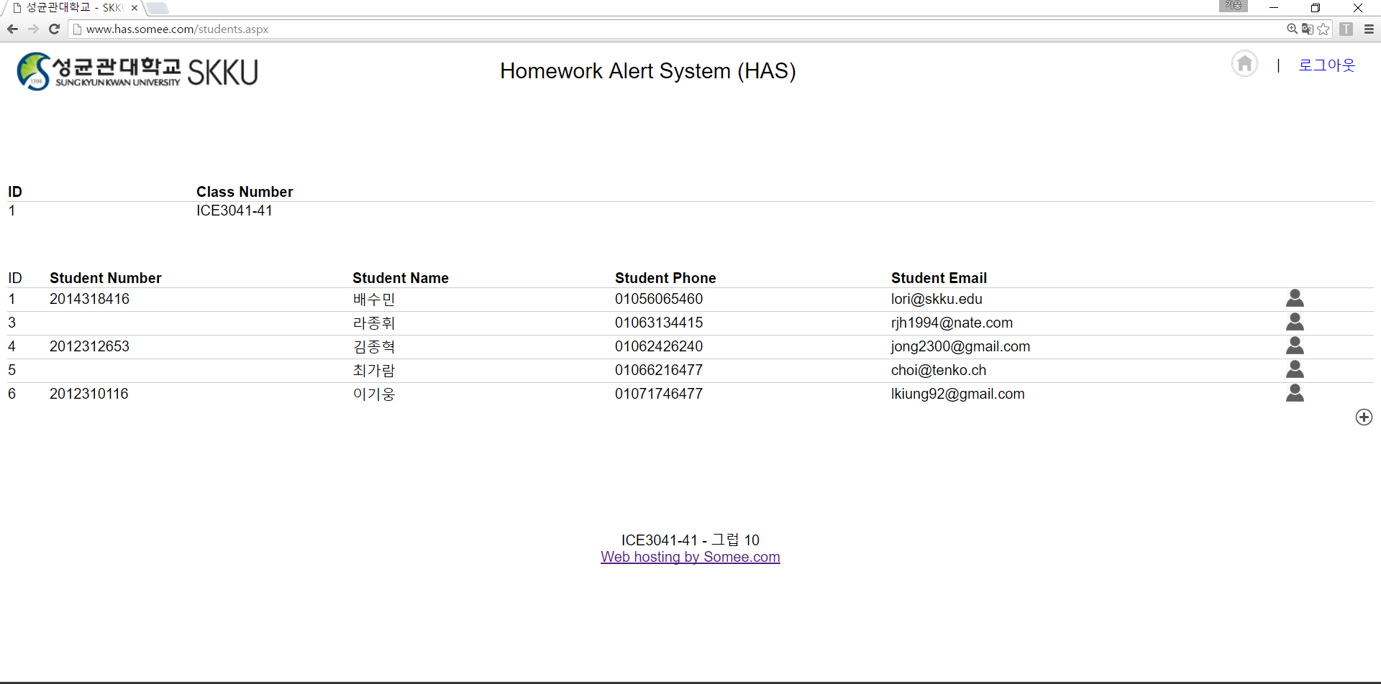
Scenario
-Edit Student
Edit each student
Add New student

Slide 22
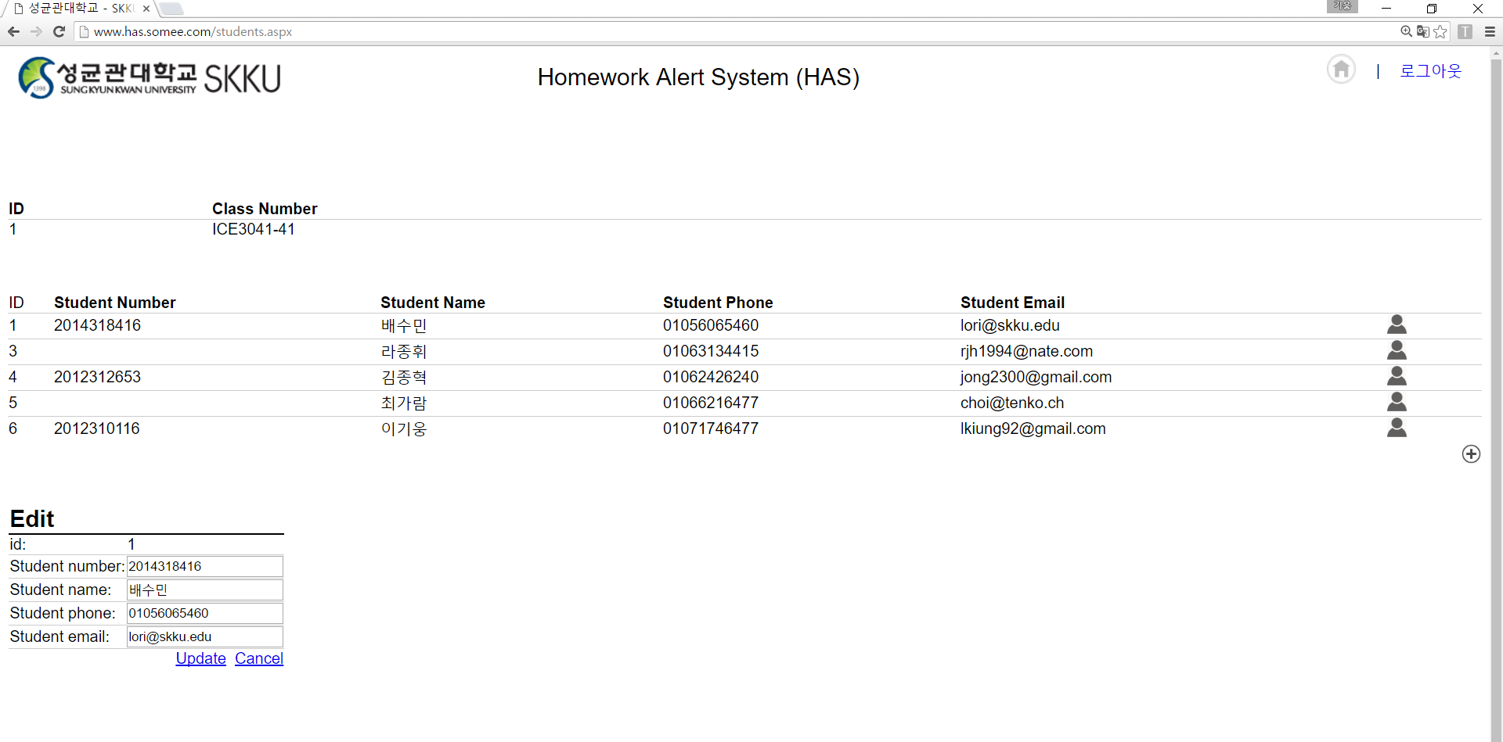
Scenario
-Edit Student
You can update students information

Slide 23
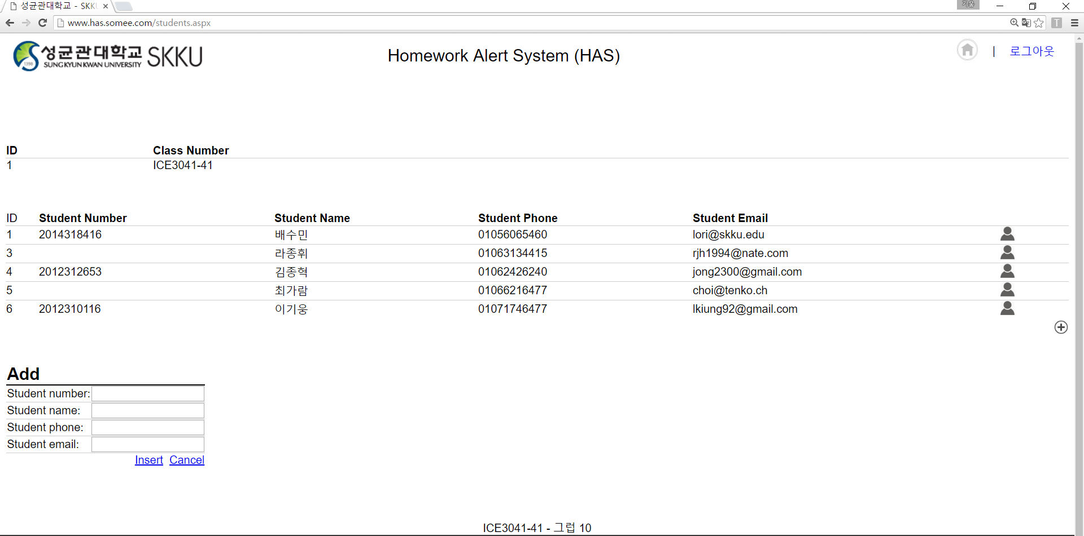
Scenario
-Edit Student

Slide 24
Scenario
-Home
Send Alert Message

Slide 25
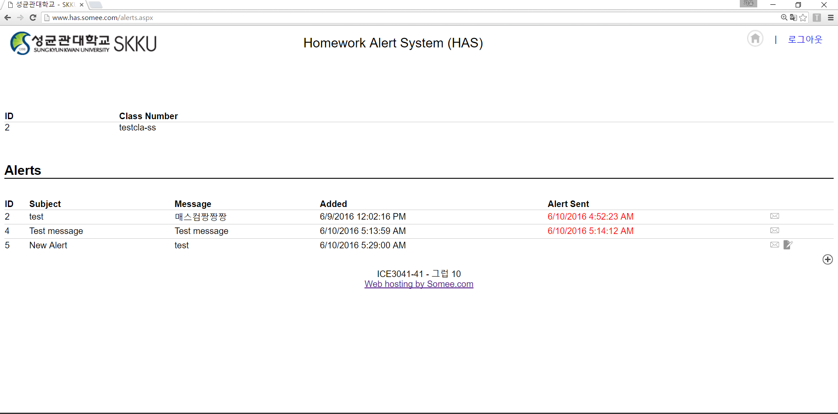
Scenario
-Send Alert Message
You can add new alert

Slide 26
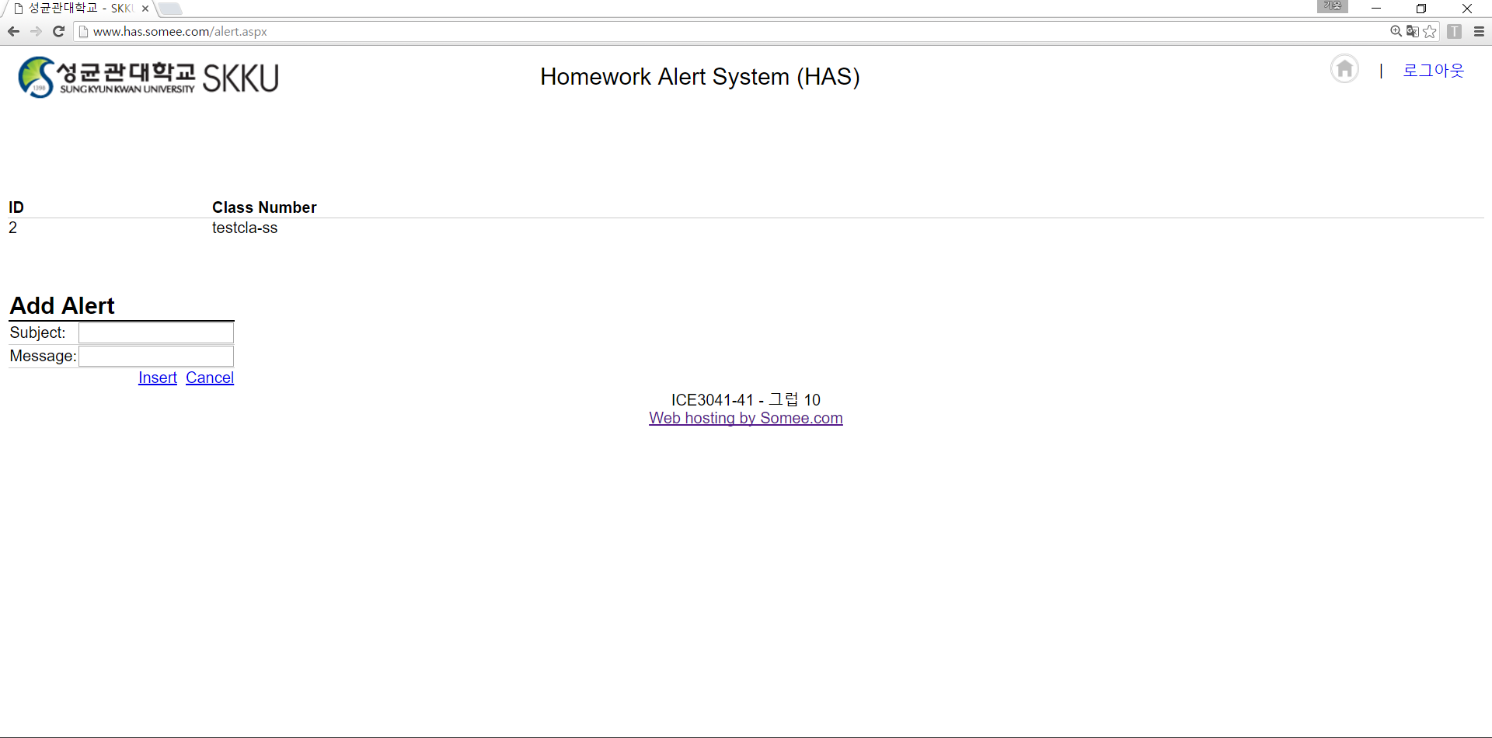
Scenario
-Send Alert Message
Insert homework Information

Slide 27
Scenario
-Send Alert Message
You can see new alert is added
Send Alert
Edit before send

Slide 28
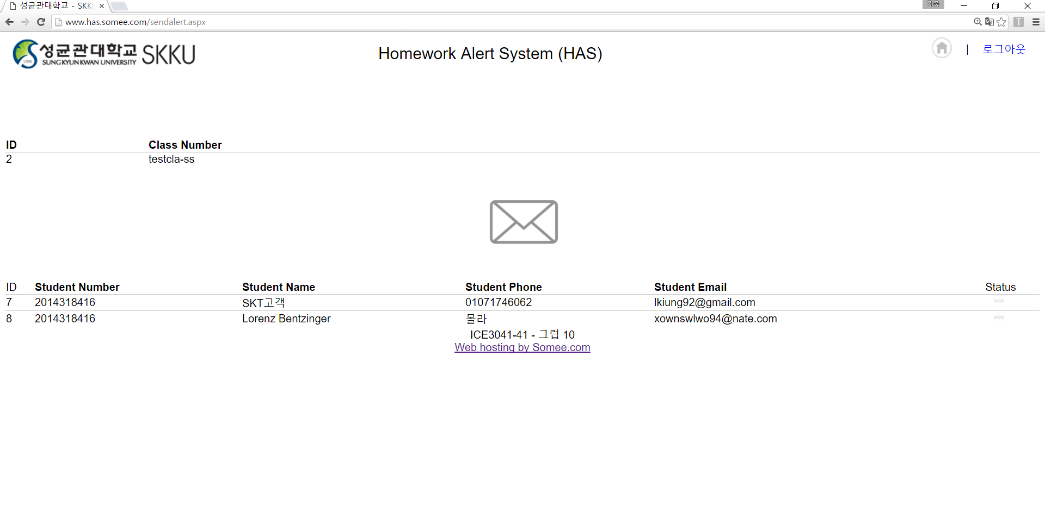
Scenario
-Send Alert Message
Click and Send
Information of receiver

Slide 29
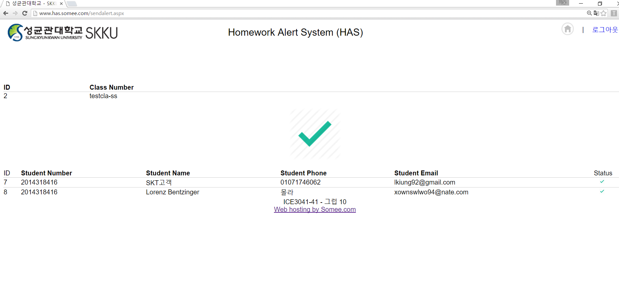
Scenario
-After send message

Slide 30
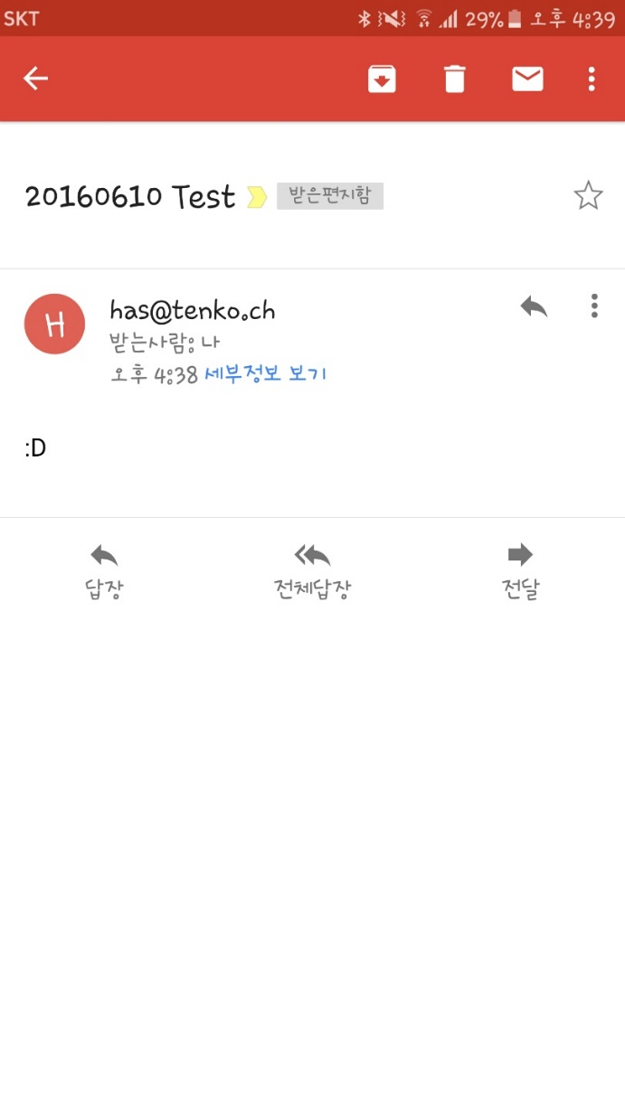
Scenario
-After send message

Slide 31
Thank You

